Slide 1
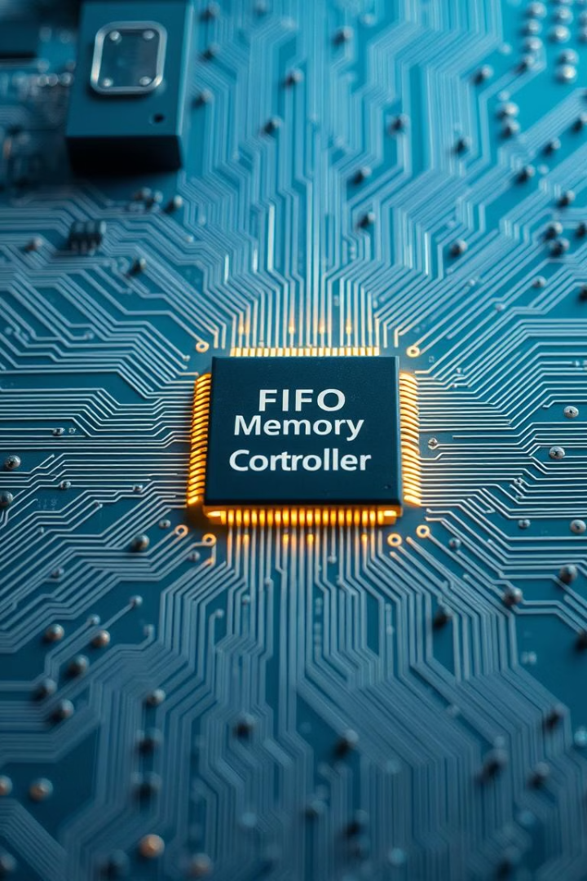
FIFO-Based Data Buffer
For UART Communication
Akshay Gowda CH

Slide 2
Objective
FIFO in Verilog is to manage data transfer data between components with different speeds or clock domains. It provides buffering, flow control, and synchronization, ensuring smooth data handling without loss. FIFO optimizes throughput, reduces latency, supports pipelining, and enhances system reliability in applications like networking, DSP, and microprocessor interfacing.

Slide 3
Why FIFO is Important?
Data Buffering: Helps store data temporarily.
Clock Domain Crossing: Enables data transfer between different clock speeds.
Pipeline Processing: Ensures smooth data flow in DSP applications.
Network and Communication: Manages data transfer in serial/parallel interfaces.

Slide 4
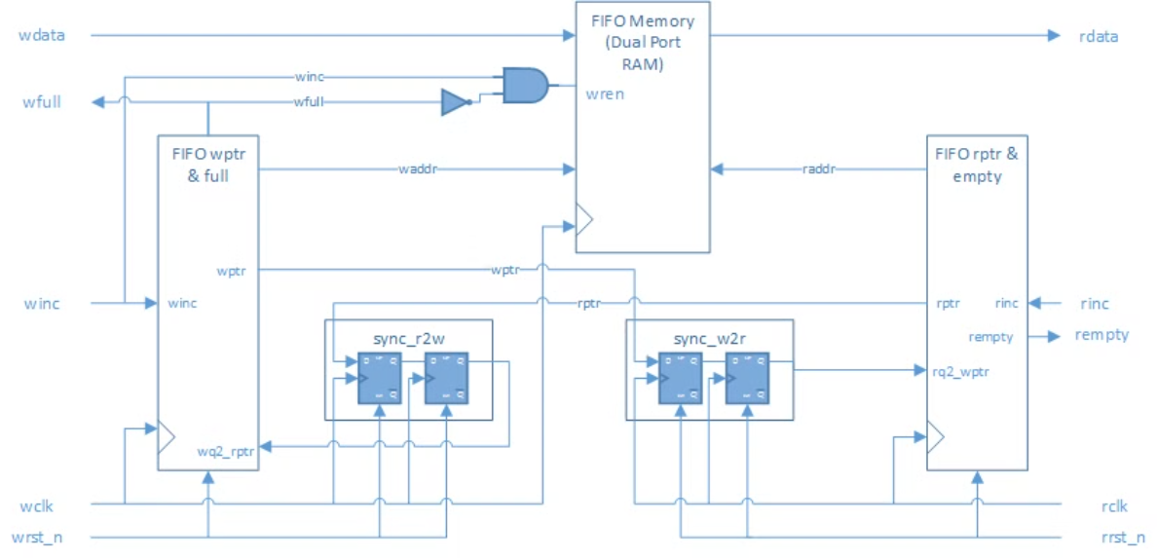
Flow Diagram

Slide 5
FIFO Architecture
FIFO consists of:
Memory Array: Stores data elements.
Read and Write Pointers: Keep track of FIFO status.
Full and Empty Flags: Indicate FIFO state.
Clock and Control Signals: Handle read/write operations.

Slide 6
Explanation of the Verilog Code
Memory Array (mem): Stores FIFO data elements.
Read Pointer (rd_ptr): Points to the location to be read.
Write Pointer (wr_ptr): Points to the location to be written.
Full and Empty Conditions:
Full: count == DEPTH
Empty: count == 0
Read and Write Operations:
Write happens when wr_en == 1 and FIFO is not full.
Read happens when rd_en == 1 and FIFO is not empty.

Slide 7
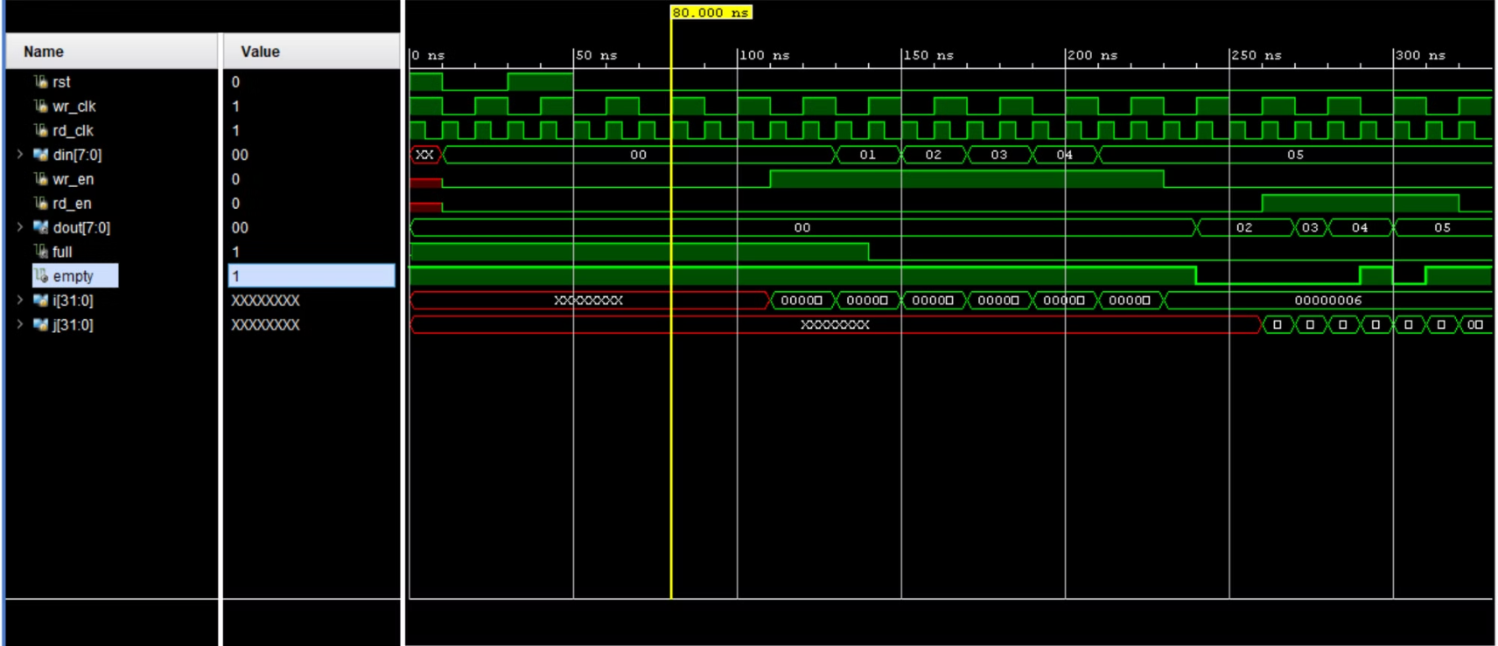
Expected graph

Slide 8
Difference Between Synchronous and Asynchronous FIFO
Feature
Synchronous FIFO
Asynchronous FIFO
Clock Domains
Single clock for read and write operations.
Separate clocks for read and write operations.
Synchronization
No synchronization required as both operations use the same clock.
Requires synchronization logic for safe data transfer between different clock domains.
Complexity
Simpler design, as both operations happen in the same clock cycle.
More complex due to additional synchronization circuits (e.g., Gray code pointers).

Slide 9
FIFO Advantages and Disadvantages
Feature
✅ Advantages
❌ Disadvantages
Data Buffering
Prevents data loss
Fixed size, cannot expand dynamically
Clock Domain Crossing
Works in multi-clock systems
Needs complex synchronization (Gray code)
Pipeline Processing
Improves speed & efficiency
Extra latency in asynchronous FIFOs
Memory Usage
Small FIFOs are lightweight
Large FIFOs consume more hardware resources
Latency
Synchronous FIFO has low latency
Asynchronous FIFO has synchronization delays
Debugging
Simple for synchronous FIFO
Harder to debug timing in asynchronous FIFO

Slide 10
FIFO Applications
Networking & Communication – Used in routers and data transmission buffers.
Data Pipelining – Helps in high-speed DSP processing.
Video & Image Processing – Buffers frames for real-time processing.
Processor-Peripheral Communication – Bridges between CPU and peripherals.

Slide 11
Conclusion
FIFO (First In, First Out) is an essential design concept in digital systems, widely used for data buffering, clock domain crossing, and real-time processing. It ensures efficient data transfer between components operating at different speeds and prevents data loss due to mismatches in processing rates.

Slide 12

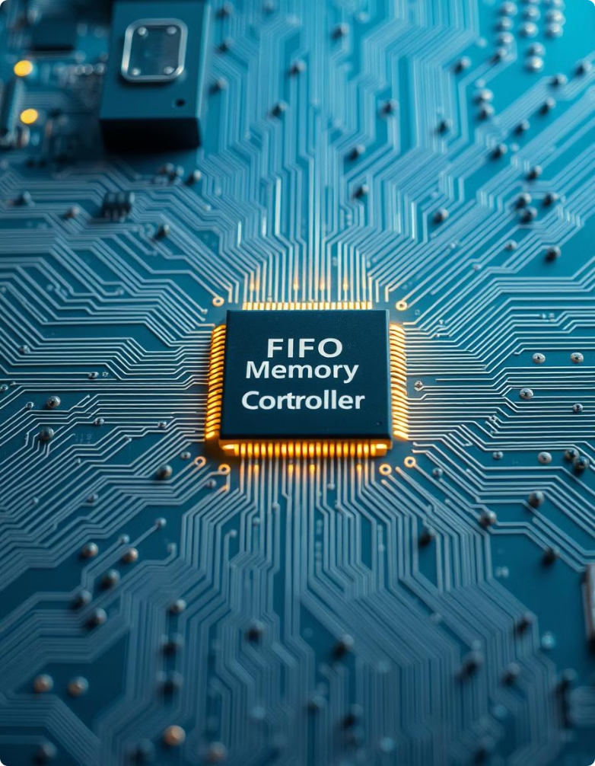
Thank you

